Slide 1
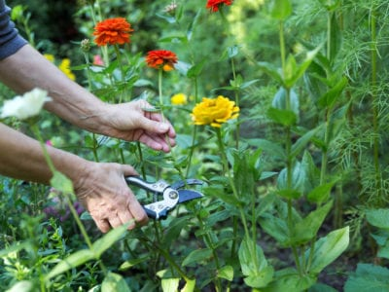
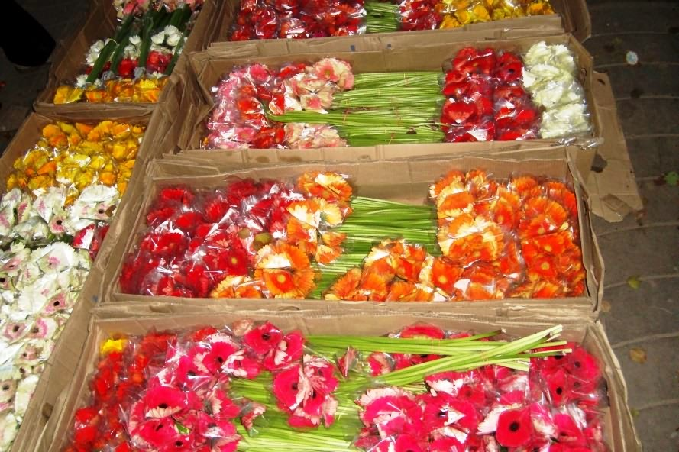
WEL
-COME

Slide 2
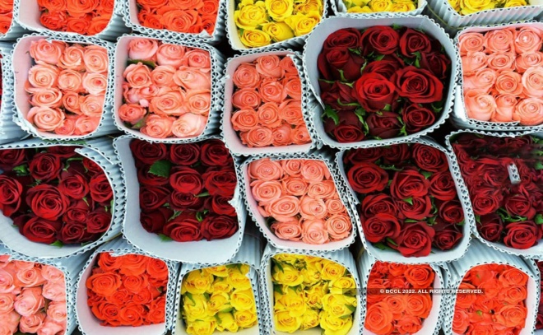
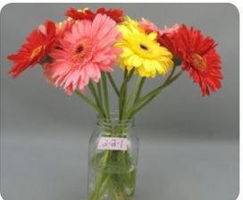
POST HARVEST MANAGEMENT OF DFFERENT FLOWER CROPS UNDER PRECISION FARMING

Slide 3
INTRODUCTION
Post harvest management:
In agriculture or horticulture postharvest management is the stage of crop production immediately following harvest including cooling, cleaning sorting and packaging.
The instant a crop is removed from the ground or separated from its parent plant it begins to deteriorate.
Postharvest treatment laregely determines final quality, whether a crop is sold for fresh consumption or used an as ingredient in processed of product.

Slide 4
Factors affecting post-harvest quality of cut flowers
Pre harvest factors:
The overall quality and condition of fresh produce cannot be improved after harvest. The postharvest life of the crops can be enhanced by pre-harvest factors.
Genetic / varietal factors:
The genetically the varieties with shorter shelf-life are generally prone to higher post-harvest losses. Genetic makeup of the crop also will decide the longevity of the flowers.
Environmental factors:
The essential environmental factors like light, temperature, humidity also affect the post harvest quality of the cut flowers. The proper management of these factors also determines the longevity of the harvested flowers.

Slide 5
Post-harvest factors:
Post-harvest activities such as harvesting, handling, storing, processing, packaging, transporting and marketing. So these factors also should be taken care at the time of handling to increase the shelf life of harvested cut flowers.
Mechanical Damage:
In India around 20 to 40% of the quality loss occurs due to physical damage in cut flowers production. When handling the harvested flowers, bruising and breakage of cut flowers should be avoided.
Pest and diseases:
The incidents of post-harvest diseases can reduce the quality around 15 -20% in cut flowers. Flowers are very susceptible to disease, not only because their petals are fragile, but also because the secretions of their nectaries often provide an excellent nutrient supply for even mild pathogens.

Slide 6
Techniques and Handling/Management of cut flowers to improve the post harvest life
Harvesting
Pre-cooling
Storage
Conditioning with chemical preservatives
Nanoparticles for longevity of cut flowers
Deleafing
Grading
Bunching
Cold storage
Packing and transport of the flowers
Quality control

Slide 7
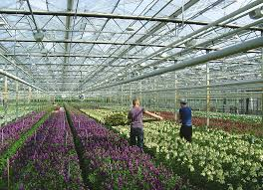
Harvesting
It is estimated that about 70% of the potential lasting quality of many cut flowers is predetermined at harvest.
Harvesting stage, method and time play an important role in this regard.
Maturity differs according to the type of flowers to be harvested.
Nearly all the cut flowers should be harvested early in the morning or late in the afternoon.
In rose harvesting is done at tight bud stage when colour is fully developed and petal have yet not started unfolding.
Standard carnations are harvested at paint brush stage for long distance markets.
Gerbera flowers are generally harvested when the outer two row of disc floret perpendicular to the stalk.

Slide 8
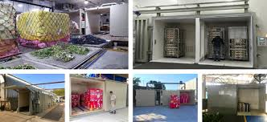
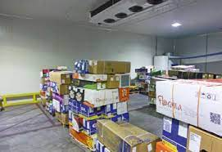
PRE COOLING
Pre cooling is done to remove field heat from the produce to reduce flower temperature quickly.
Generally two methods are used a) Room cooling b) Forced cooling.
In room cooling, the flowers are cooled by placing the flowers held in buckets in a cooler.
In later methods the flowers are packed in perforated box, which are subjected to cool air blast for certain period in closed room.
The temperature range should be in between 1.7 to 40C. It takes about 30 minutes to cool the flower on forced cooling depending on the flower type.
The success of pre cooling depends upon the proper temperature and relative humidity (90-92%).

Slide 9
Pre cooling temperatures for different cut flowers
S. No. | Cut flower | Temperature(0 C) | Duration
1 | Anthurium | 13.0 | 21 weeks
2 | Alstromeria | 4.0 | 9 days
3. | Carnation | 1.0 | Few hrs
4. | Chrysanthemum | 0.5-4.0 | 4 hrs
5. | Gerbera | 4.0 | Few hrs
6. | Gladiolus | 4.5 | 6-9 days
7. | Rose | 1.0-3.0 | 4-5 days

Slide 10
STORAGE
Temperature and relative humidity play a very important role during storage. Low temperature reduces respiration, transpiration, enzymatic activity and microbial activity.
Most of the flowers are well stored between 20 – 40 C except tropical orchids and anthurium which have to be stored above 100 C and the relative humidity should be 90-95%.
Dry Pack Storages
Wet Pack Storages
Dry pack storage is for long term storage and the flowers are stored at pressure between 10 – 60 mm Hg at 00 C – 20 C.
Wet storage is for short period. The cut ends of the flower are dipped either in water or preservative solution for 4-6 hr or more at 40 C.

Slide 11
STORAGE TEMPERATURES FOR DIFFERENT CUT FLOWERS
Flowers | Storage Approximate storage | Temperature (0C) period
Rose (in preservative) Rose (dry pack) | 0.5-20.5-0 | 4-5 days 2 weeks
Carnation (flowers) Carnation (buds) | 0.5-00.5-0 | 3-4 weeks 4-12 weeks
Chrysanthemum | 0.5-0 | 3-4 weeks
Anthurium | 13 | 2-4 weeks
Gerbera | 1-4 | 1-2 weeks
Gladiolus | 2-6 | 6-8 days
Lilium | 0-1 | 2-3 weeks

Slide 12
CONDITIONING WITH CHEMICAL PRESERVATIVES
Before packing they are given a treatment called pulsing to extend their shelf life
The main ingredient of various pulsing solutions is sucrose, which is a used higher concentration then in preservative formulations.
Eg:
Raktagandha cut roses, by sucrose for 24 hrs was found to be the best. Apart from sugars, pulsing is done with silver nitrate (AgNO3), calcium chloride (CaCl2), calcium nitrate (CaNO3), sodium thiosulphate (STS) etc.
Important biocides used for treating cut flowers are 8-hydroxy quinoline citrate (200-600 ppm), aluminium sulphate (100300 ppm), citric acid (50-1000 ppm), slow release chlorine compounds and ammonium compounds (50-200 ppm)
(Arora and Singh, 2002).

Slide 13
EXTENDING THE SHELF LIFE BY USING CHEMICAL PRESERVATIVES
Cut flower | Preservatives | Vase Life
Rose | 3-5% sucrose and 300 ppm Al2 So4 | 6-9 days
Gerbera | 200 m g/l of 8 HQS | 4-5 days
Chrysanthemum | 2% Sucrose and Al2 So4 | 12-20 days
Preservatives are known to improve the quality and longevity of cut flowers. The ingredients of the floral preservatives are water, sugar, minerals, germicides, organic acids, salts, anti-oxidants, ethylene inhibitors, growth regulators and enzyme inhibitors.

Slide 14
DIFFERENT GERMICIDES USED IN THE VASE SOLUTION
Name of the compounds | Commonly | Ranges used symbols
8-hydroxyquinoline sulphate | 8-HQS | 200-600 ppm
Silver nitrate | AgNO3 | 10-200 ppm
Silver thiosulphate | STS | 0.2-4 mM
Thiobendazole | TBZ | 5-300 ppm
Quaternary Ammonium | QAS | Salts 5-300 ppm
Aluminium sulphate | Al (SO4 ) | 200-300 ppm

Slide 15
EFFECT OF PULSING SOLUTION ON EXTENDING VASE LIFE OF CUT FLOWER CROPS
Pulsing Solution | Reference
Pulsing with 50 mg/lt 8-HQS + 5% sucrose for 20 hours results in longest vase-life (7.5 days) against vase-life of 3.17 to 4.17 days in non-pulsed Chrysanthemum flowers | Kesta (1989)
Pulsing of cut blooms of chrysanthemum cv.”Guangdong Yellow” with 5% sucrose+ 0.3 mM STS OR 5% sucrose + 50 ppm AgNO? + 150 ppm citric acid for 16 hours follwed by storage at 0°C for upto 5 weeks shows increased flower soluble sugar during first 2 weeks of storage with STS. | Su et al.(1991)
The longest vase-life (13 days) and greatest floretdiameter (7.8 cm) are noticed in pulsed gladiolus spikes cv. White Prosperity, in a vase solution containing 8-Hydroxyquinoline citrate (8-HQC). | Singh and Sharma (2002)
Pulsing of rose cv. First Red with 200ppm 8-HQC + 3 per cent sucrose resulted in maximum vaselife of 20.28 days compared to control (14.12 days) | Jain et al. (2007)

Slide 16
EFFECT OF HOLDING SOLUTIONS ON VASE-LIFE OF CUT FLOWER CROPS
HOLDING SOLUTIONS | REFERENCES
Chrysanthemum, kept in 20% sucrose and 500 ppm 8-HQC solution results in maximum vase-life (13.6 days). | Lukaszewska (1980)
The solution containing 5% sucrose + 50 ppm AgNO, +200 ppm 8-HQC extends vase-life of carnation flowers 2.4 times as compare to the control (distilled water). | Chung et al.(1986)
50 ppm 8-HQC+1.5 percent sucrose resulted in maximum vaselife (18.66days) of roses against control. | Jain et al. (2006)
Sim when flowers are kept in a solution of 0.5 mM STS + 2% sucrose as compare to 5.4 days in distilled water (control). | Sharma (1992)
150 ppm citric acid+500ppm Al2(SO4)3 + 2 % sucrose extended the vase life of chrysanthemum cv. Kanchil by 4.56 days as compred to distilled water. | Jain et al. (2009)

Slide 17
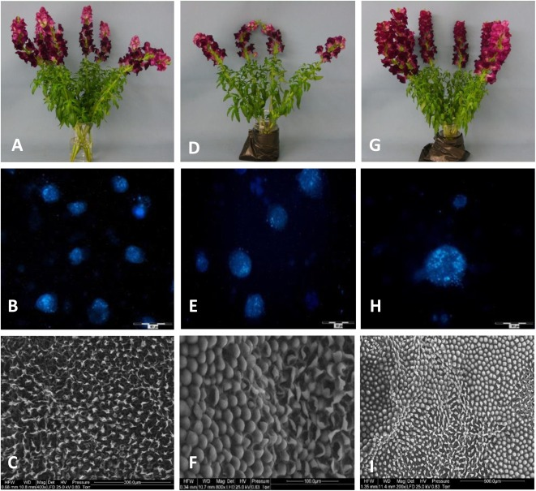
NANOPARTICLES FOR LONGEVITY OF CUT FLOWERS
Nano meter sized silver (Ag+) particles (NS) are reported that, they are more strongly inhibit the bacteria and other microorganisms than Ag in various oxidation states; Ag0, Ag+, Ag 2+, Ag 3+
Usage of nano-silver compounds (NS) in pulsing or in vase solution treatment for cut flowers is relatively new aspect of post-harvest management of cut flowers

Slide 18
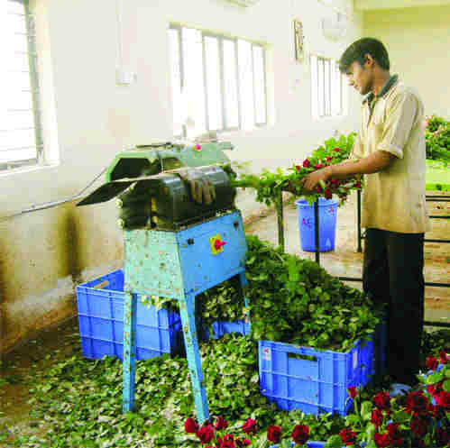
DELEAFING
The leaves from the lower portion of the stem (4-5 cm) are removed by manually or by machine and stems are put in buckets containing bleaching powder (chlorine) 20 mg/lit or (20 ppm) and citric acid 40 mg/ lit (40 ppm).
Citric acid reduces the pH of water (it should be up to 3-3.5) it helps for the uptake of water and citric acid add sugar which act as food for the flowers.

Slide 19
GRADING
The quality parameter for grading is as follows.
Long stemmed varieties are graded from 40 cm onwards with the difference of 7 cm whereas short stemmed varieties are graded from 35cm to 50 cm with the difference of 7 cm or in the level grading stems should be consider of same height.
b. Leaves should be dark green and healthy. There should not be any yellowing due to micronutrient deficiency; leaves should be free of dust, chemical residue, chemical injury, damage by spider mites or powdery mildew etc.
c. The flowers should not be bullhead, too open, too tight, with bent neck, damaged by thrips or botrytis etc.
d. Bud size should be representative to the variety.
e. The length of the neck should not be too much.

Slide 20
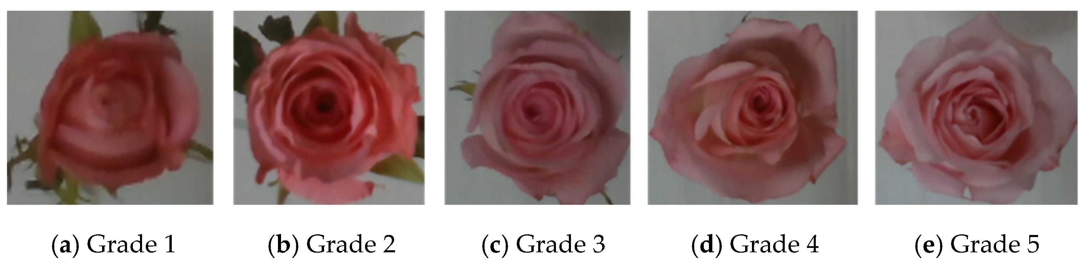

Slide 21
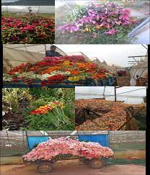
BUNCHING
The graded stems are made in to bundles of 20 each and tied loosely with rubber band.
The bud should be wrapped with 2- ply soft corrugated paper white or brown) and tied loosely with rubber band to secure the bud in position.
The wrapping paper should project at least 2-3 cm above the bunch to protect the bud from thorns or from coming in contact with the box.
There are two different types of bunching

Slide 22
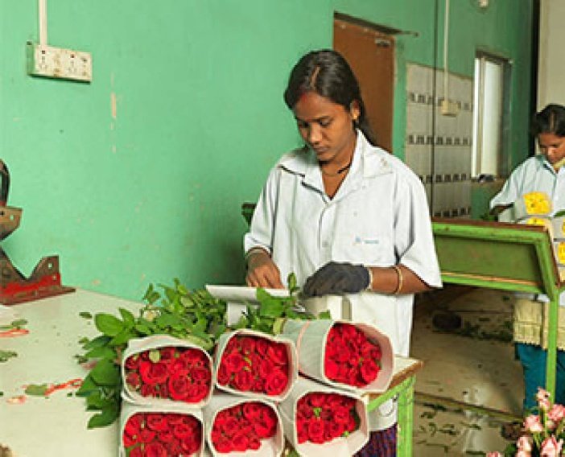
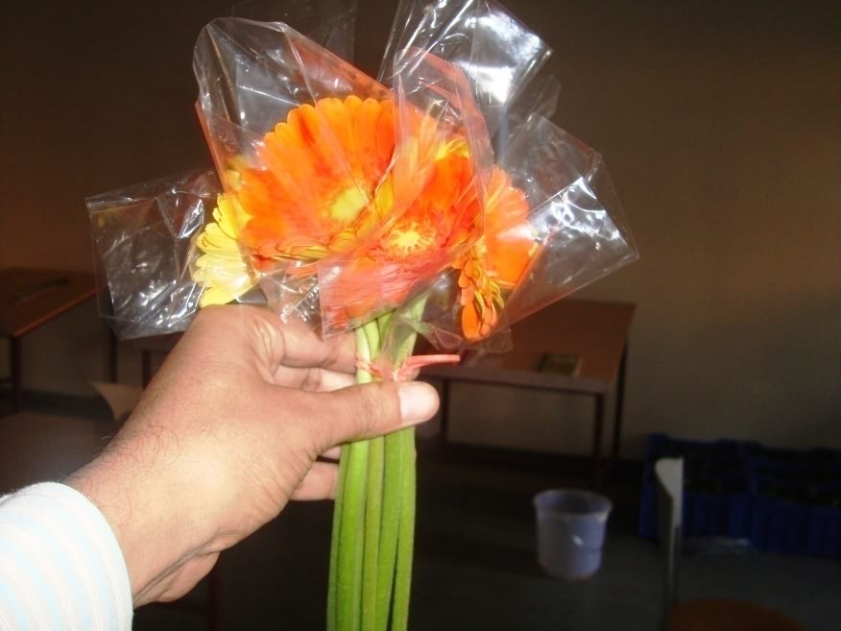
Staggered bunching: This type of bunching is very useful to avoid damage to the buds by mutual pressure two different levels are packed in a same bundle. E.g. generally for long stem variety having bigger bud size flower this method is useful.
Level head bunching: The stems, which can be packed keeping all the buds in the same level. This method is used in short stem variety and having small bud size flowers.

Slide 23
COLD STORAGE
After pre-cooling the temperature of the flowers (field heat)
Flowers should be transported immediately in to cold storage for minimum 6 – 7 hrs. At 2-30C, with stems dipping in water.
The cut roses can be stored up to 3-4 days maximum without affecting the vase life of flowers.
Relative humidity needs to be monitored and controlled in storage. Control can be achieved by a variety of methods.
1. Operating a humidifier in the storage area
2. Regulating air movement and ventilation in relation to storage room load
3. Maintaining refrigeration coil temperature within the storage room
4. Using moisture barriers in the insulation of the storage room or transport vehicle
5. Wetting the storage room floor
6. Using crushed ice to pack produce for shipment
7. Sprinkling perishables, flowers with water

Slide 24
WET STORAGE
In wet storage, flowers are stored with their base dipped in water or preservative solution for a short time. During wet storage, flowers are kept at 3-4oC temperature slightly higher than that used for dry storage
Wet storage temperature and shelf life of important flowers
Flowers | Temperature (0C) | Shelf life (weeks)
Antirrhium | 4 | 4
Carnation | 4 | 4
Chrysanthemum | 1 | 3
Gerbera | 4 | 3-4
Lily | 0-1 | 6
Rose | 4 | 4
Source- Senapati, et al., 2016

Slide 25
DRY STORAGE
Dry storage method is used for long term storage. In this method, fresh flowers are harvested in the morning, graded and sealed in plastic sleeves/ bags or boxes to prevent the loss of moisture. Prior to storage, flowers may be pulsed with floral preservatives containing sugar, anti-microbial and anti-ethylene compounds.
Recommended dry storage temperature for important flower crops
Flowers | Temperature Shelf life (0C) | (weeks)
Carnation | 0-1 | 16-24
Lily | 1 | 6
Rose | 1 | 3
Anthurium | 13 | 4
Source- Senapati, et al., 2016

Slide 26
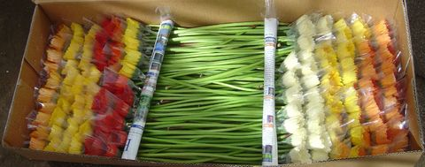
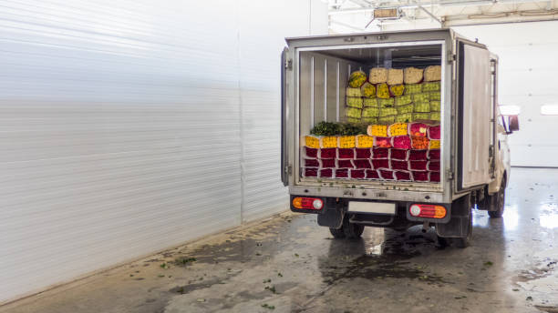
PACKING AND TRANSPORT OF THE FLOWERS
The method of packing depends on crop, flower, method of transport and market.
The principle of packing is to keep the flowers for long time and retain quality by lowering the rate of transpiration and cell division during transportation and storage.
The ideal packing should be air tight, moisture proof and strong enough to withstand handling, transport and staking.

Slide 27
Types of packaging
I. Primary packaging - container that directly holds the product
o Eg., Wrapping materials (paper, polythene),vases, bouquests, carton, crates, etc
II. Secondary packaging - any outer wrapping that help to store, transport, inform, display and protect the product
Eg. CFB’s, decorated carton, gift boxes, etc
III. Tertiary packaging - grouping of products for storage and transportation.
Eg. Pallet Boxes, CFB’s, cartons, plastic/wooden boxes.
The bunches are packed in 5 ply boxes in such a way that flower heads faces in opposite direction, i. toward the width. The bunches should be placed in a row along with the width. The second layer is placed opposite to the first layer. In the packing box the layers of the flower are covered with soft paper.

Slide 28
QUALITY CONTROL
There are some special grade standards and certain quality control procedures for cut flowers for different countries.
Some marketing channels, for example the European markets the channel should have internal quality control systems that provide a continuous checking on quality of cut flowers.
The most important quality parameter to assess the cut flower quality is freshness or vase life.
But it is very difficult to assess the quality and freshness of the flower visually, so this parameter being important for export, the producers and receivers should set up a quality control program to enhance the freshness of the flowers that will helps to assess the quality of the exported cut flowers

Slide 29
ADVANCES IN PACKAGING AND STORAGE OF IMPORTANT FLOWER CROPS
FLOWER | PACKING | STORAGE
Rose | Packed in bundles of 20 each and tied with string or rubber band | 2 weeks in dry storage
Gerbera |  | 1 week at 35°F (2°C), even this short storage period
Chrysanthemum | Display boxes of 91x43x15 cm dimensions. | Stage 3 buds can be stored up to 2 weeks and stage 4 buds up to 3 weeks at 31-34°F (0-l°C).
Anthurium | Shredded newsprint | Vase life was increased by 50% when flowers were stored in air at 13oC (55° F) or in 2% oxygen at room temperature for up to 2 weeks.
Carnation | Card board boxes having dimensions of 122x50x30 cm | 1° C (34° F) in a box lined with polyethylene and newspaper. Open flowers (stage 3 or 4) can be stored 2 to 4 weeks

Slide 30
EFFECT OF NANOTECHNOLOGY IN IMPROVEMENT OF VASE LIFE IN CUT FLOWERS
In the combination of sugar and nano silver, sugar act as an energy source and nano silver particles are responsible for water retention.(Kalayeh et al., 2011) also found better result in vase life of Rose when it was treated with nano silver particles.
When nano silver particles are used with the combination of 8-hydroxyquinoline sulphate and found that it is effective for increasing flower diameter and bud openings.
Carnation
To improve the vase life of flowers and suppression of ethylene biosynthesis gene level many ethylene inhibitors like nitric oxide, silver thiosulphate and 1-MCP are used. Despite of all these ethylene inhibitors, some chemicals containing silver can also use to prevent the blockage of xylem and to inhibit the growth of bacteria and other microorganism, as it has an antimicrobial activity (Feng et.al, 2000, Rai et.al, 2008)

Slide 31
REFERENCES:
Chung, G.Y., Lee, J.S. and Kim, Y.R. (1986). Effect of silver thiosulphateand silver nitrate on the vase life and senescence of cut carnation flowers. J. Korean Soc. of Hort. Sci., 27(3): 275-282.
Feng, Q.L., Wu, J., Chen, G.Q., Cui, F.Z., Kim, T.N., Kim, J.O. 2000. A mechanistic study of the antibacterial effect of silver ions on Escherichia coli and Staphylococcus aureus. John Wiley & Sons, Inc.
Jain, Ritu, Bhalla, R. and Dhiman, S.R. (2007). Effect of pulsing treatments on postharvest life of rose cv. First Red. Journal of Ornamental Horticulture. 10(3): 143-147.
Jain, Ritu, Gupta, Y.C., Bhalla, R., Dhiman, S.R and Thakur, R. (2006). Standardization of holding solutions to increase the vase life of green house grown rose cv. First Red. In: Current Scenario in Temperate Horticulture. eds. (D.K. Kishore, S.K. Sharma and K.K. Pramnik), New India Publishing Agency, Pitampura, New Delhi. 489-495 pp.
Kalayeh, S.M.O., Mostofi, M., Basirat, M. 2011.Study on Some Chemical Compounds on the Vase Life of Two Cultivars of Cut Roses. Journal of Ornamental and Horticultural plants, 1(2):123-128.

Slide 32
Lukaszewka, A. (1980). The effect of sucrose and 8-hydroxy quinolinesulphate on keeping qualities of bud-cut chrysanthemum flowers and level of reducing sugars in the florets. Acta Agrobot, 33(1):93-101.
Rai, M., Yadav, A., Gade, A.K. 2008. Silver Nanoparticles as a New Generation of Antimicrobials. Biotechnology Advances, 27(1):76-83.
Senapati, A. K., Raj, D., Jain, R. and Patel, N. L. 2016. Advances in Packaging and Storage of Flowers. Commercial Horticulture, pp 473-488. Publishing Agency, New Delhi, India.
Sharma, S.M. (1992). Studies on pulsing, cold storage and holding solution with respect to vase life of carnation, chrysanthemum and gladiolus cut flowers. M.Sc. Thesis submitted to Dr. Y. S. Parmar University of Horticulture and Forestry, Nauni, Solan (H.P.).
Singh, A.K. and A.K. Tiwari, 2002. Effect of pulsing on postharvest life of Rose v. Doris Tystermann. South-Indian-Hort., 50: 140-144.

Slide 33
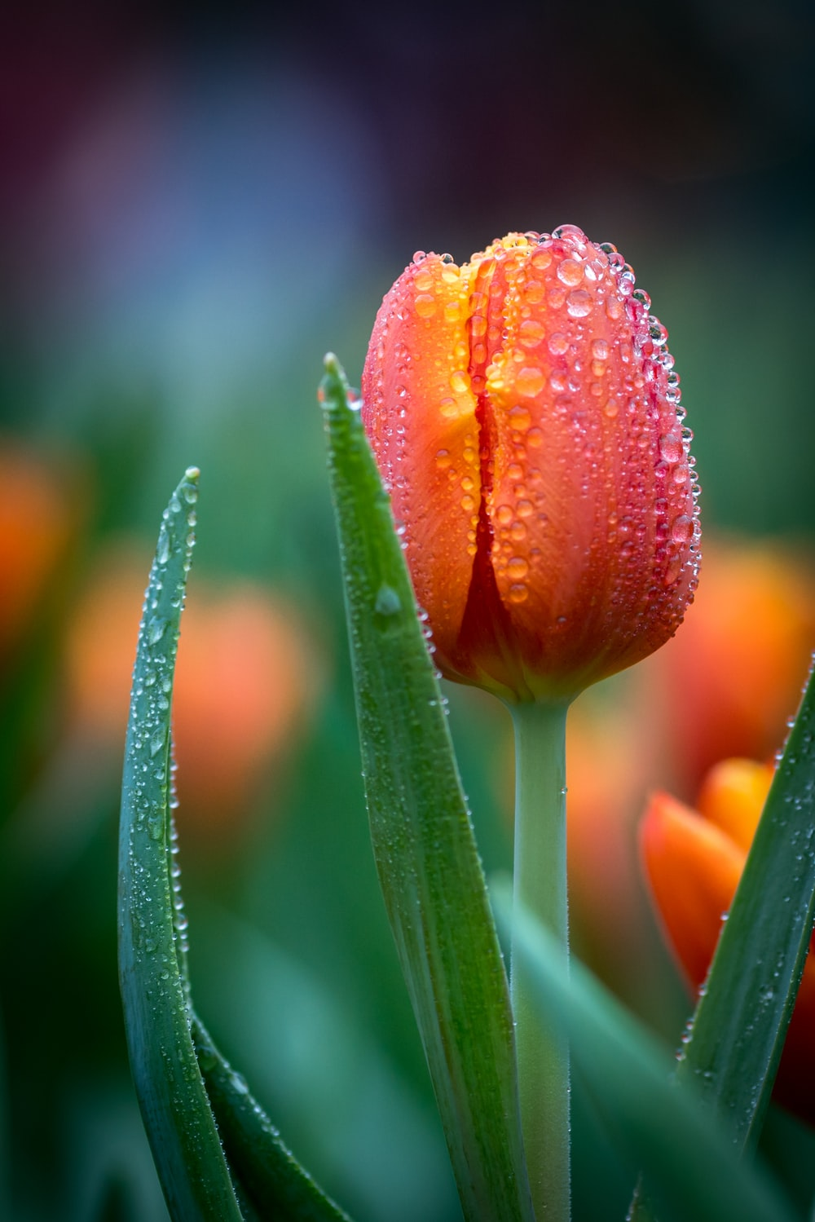
.
Thank You

